Slide 1
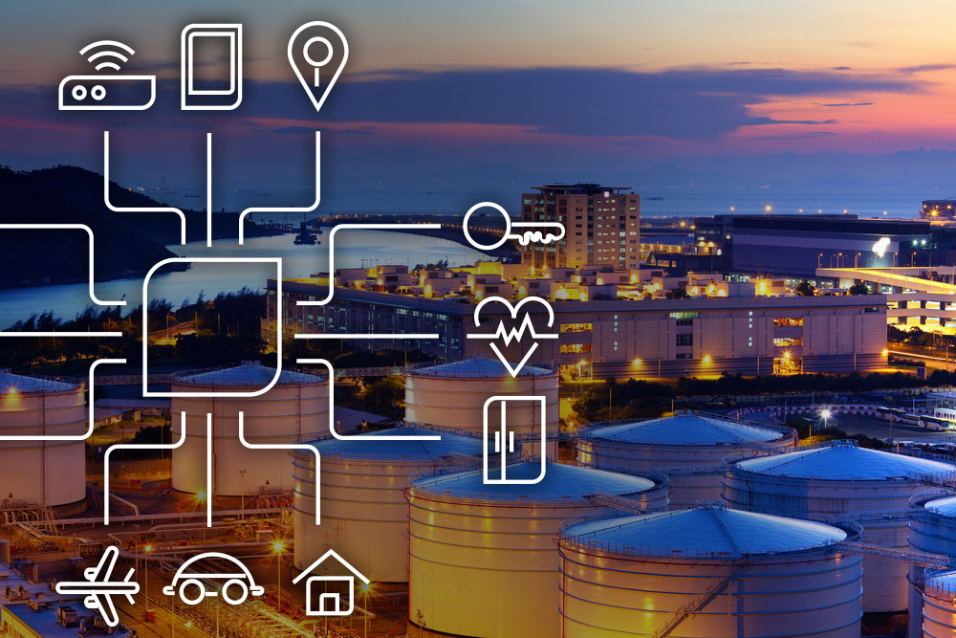
Mardhani Riasetiawan
Cloud.wg.ugm.ac.id

Slide 2
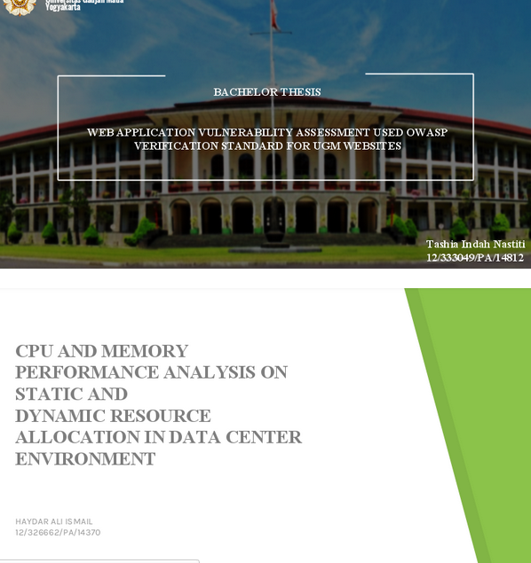
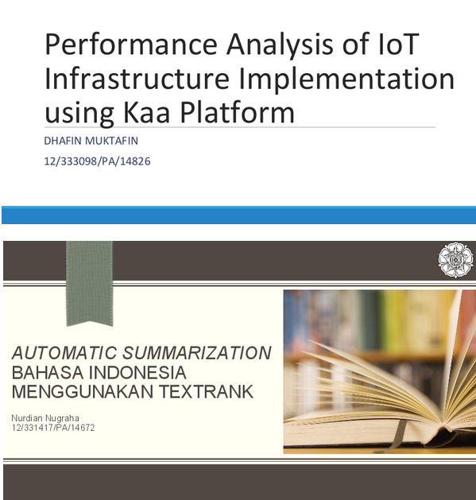
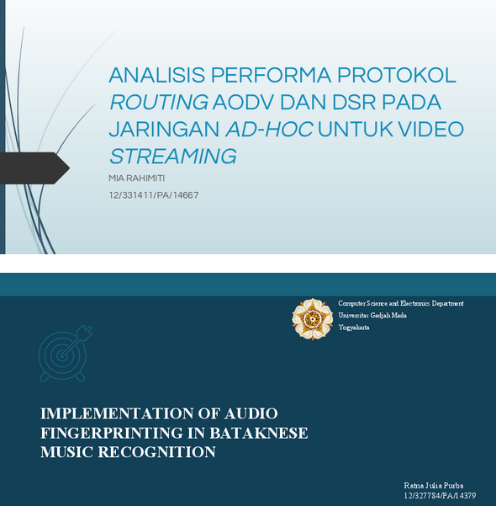
Cloud.wg.ugm.ac.id

Slide 3
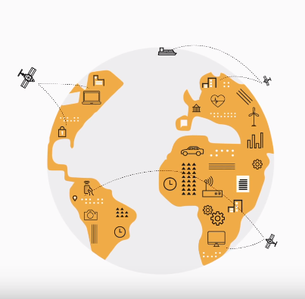
Challenges
Humanless
Precise
Fast
Reliable
Manageable

Slide 4
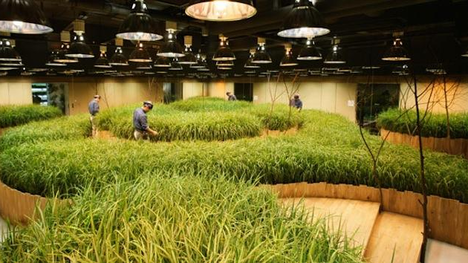
Farming
IoT-Lamp : ultraviolet
Plant Control
Monitoring
Water Management
Air Supply & Weather Modelling

Slide 5
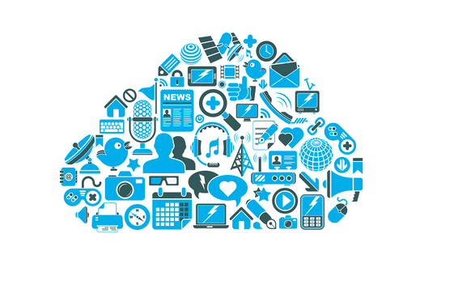
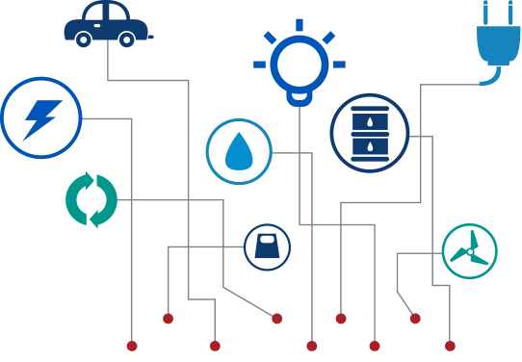
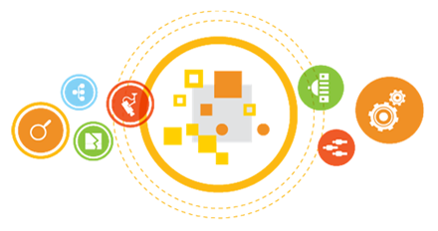
IoT
Cloud
BigData
Active devices
Data collection
Response
Tools
Infrastructure (hardware, storage, processing)
Platform (tools, build apps)
Software (services)
Data Management
Data Processing
Data Analysis & Visualization

Slide 6
Our Research

Slide 7
G-Connect Project
2017 | #merajutkonektivitas

Slide 8
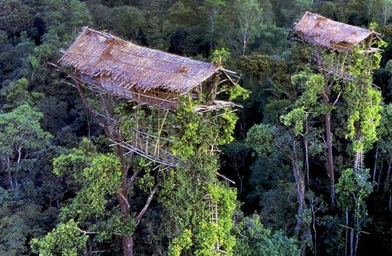
un-equal connectivities
many school, students, and communities place in remote area without connectivities.
access to knowledge limited, interaction with ‘something news’ are impossible.
current infrastructure provide limited communication facilities.

Slide 9
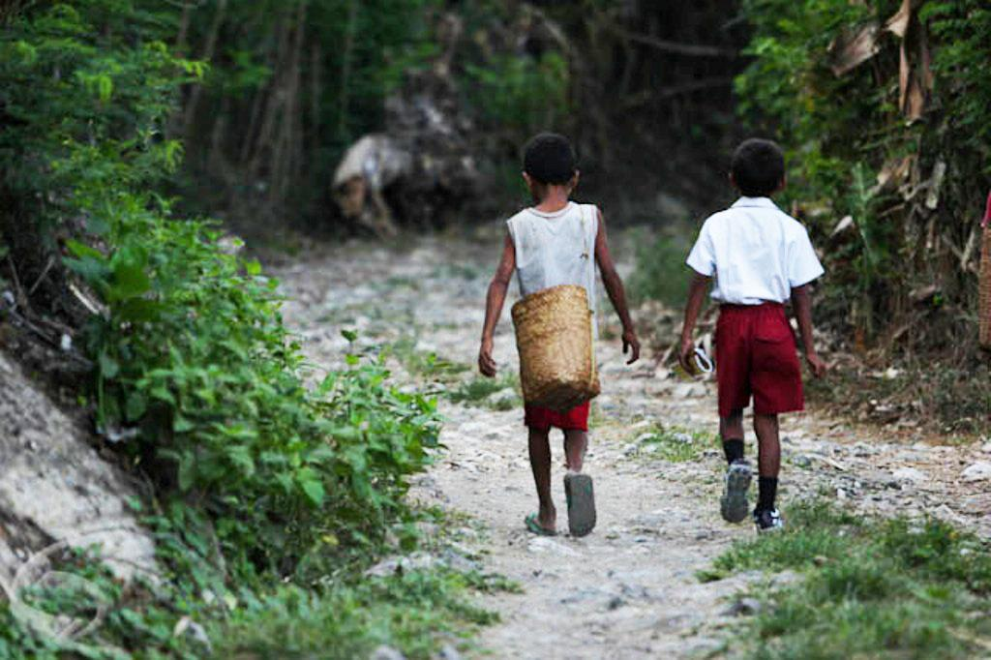
Our Ideas
connectivities and access for small and temporary areas
inter-networks for cover more wider area

Slide 10
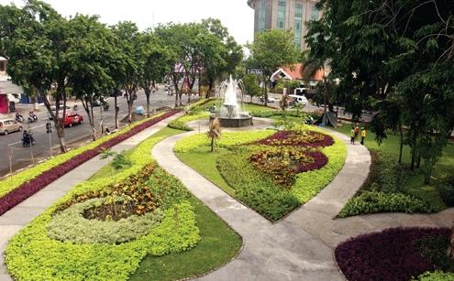
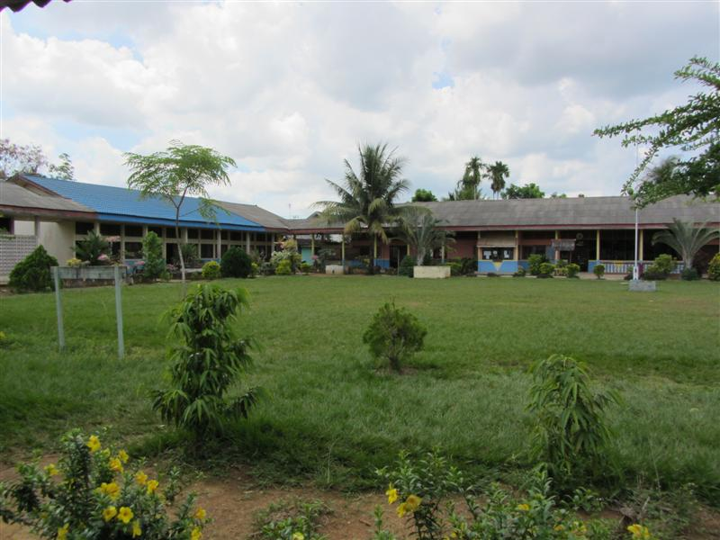
Deliveries
internet + content + communication in remote area
share infrastructures
remote area
public space
school and communities

Slide 11
concepts
independent connectivity distribution in remote-small area.

Slide 12

skynetworks
loon distribution area
mobile distribution area
independent network area

Slide 13
Baloon
opensky networks
solar paper panel
powerbank, mini router & wireless
safety wire & backup access
mini & mobile data center

Slide 14
specification
Balon
at least 30 days capabilities to up in the air
Network & Access Tools
single board router computer
power bank
wireless devices
backup link to base station
Solar paper panel for generating the power
receiver
power
SBC
broadcaster
backup link

Slide 15
Tokenisasi Lahan
Cloud based processing project

Slide 16
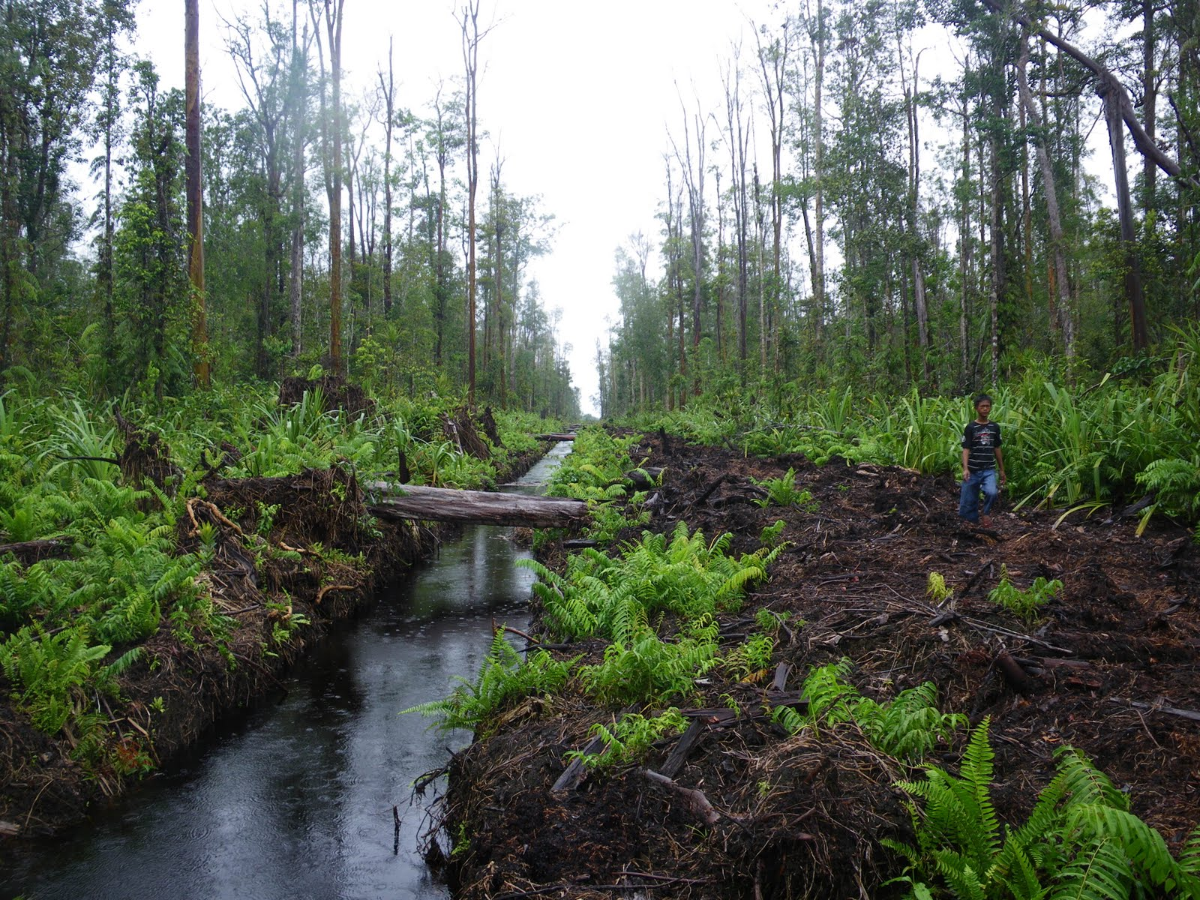
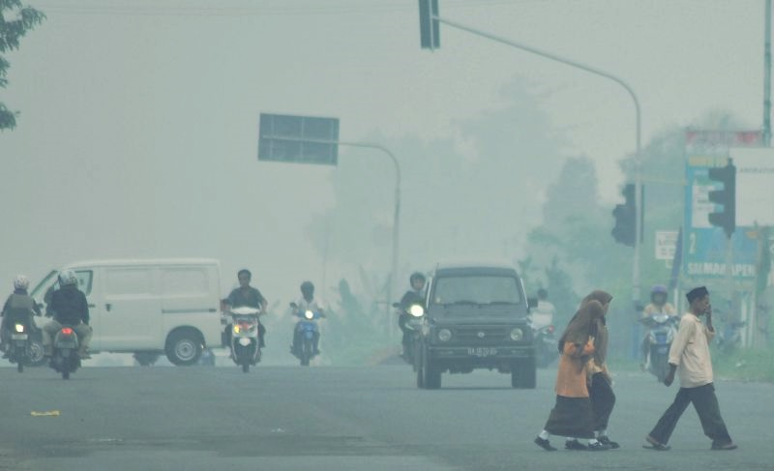
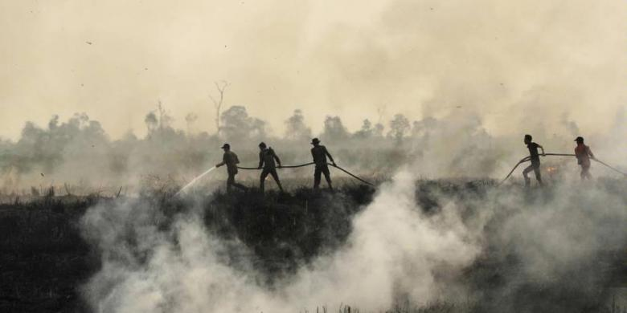
Lahan Gambut

Slide 17
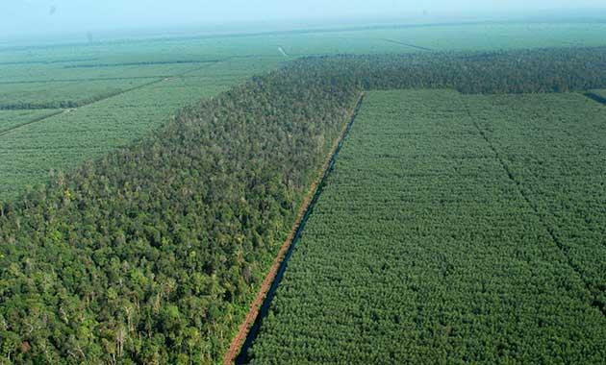
Dimensional approach
Lahan dibagi dalam dimensi
Setiap dimensi memiliki ukuran bervariasi
Dimensi memiliki nilai/value
Value ⇒ Rupiah
Petani bisa memiliki satu atau lebih dimensi

Slide 18
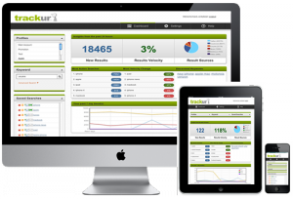
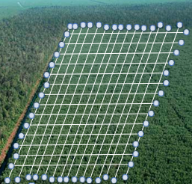
arsitektur
Cloud
IoT
BigData
Management

Slide 19
GamaCloud
Cloud infrastructure

Slide 20
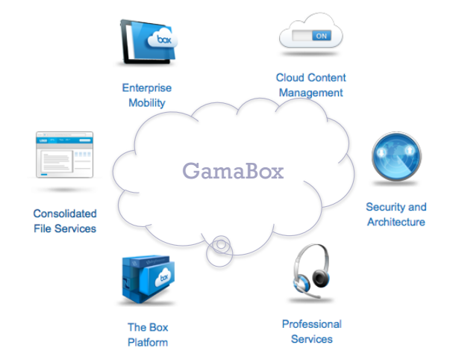
Cloud
Simple-medium Hardware
Software (bundled on OS)
Cloud technology and apps
On the single box and access

Slide 21
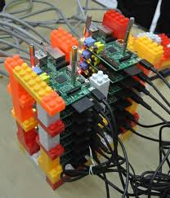
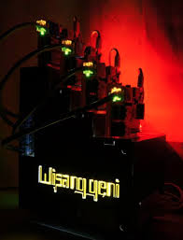
Prototype → Production
2014
Cluster+Lego
2015
Cloud Data Center

Slide 22
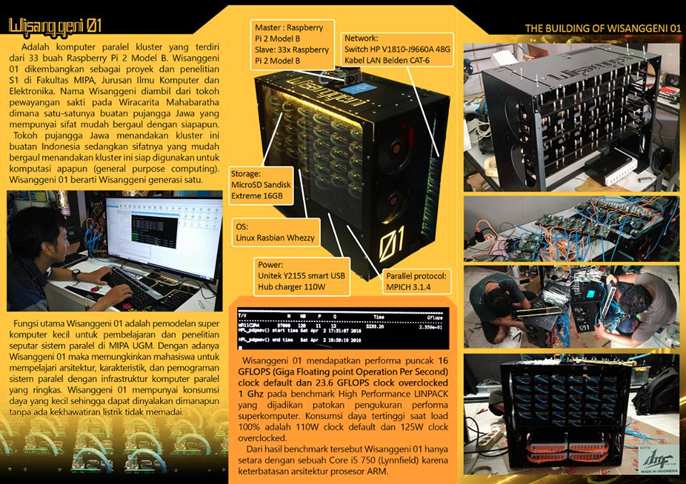

Slide 23
Big data management platform

Slide 24
DALA - a big data management platform
master data management
self managing data management
self assignment data management
real time data acquisition
streaming from the IOT
multipurpose data stream
real time visualisation
intelligence visualisation
predictive visualization
single platform with multiple ad-ons features
Big data frameworks
Data Science Platform
comprehensive
business process support
inject+integration business process
reconfigurable business process
DALA2 Next Generation
DALA Future
DALA Forward

Slide 25
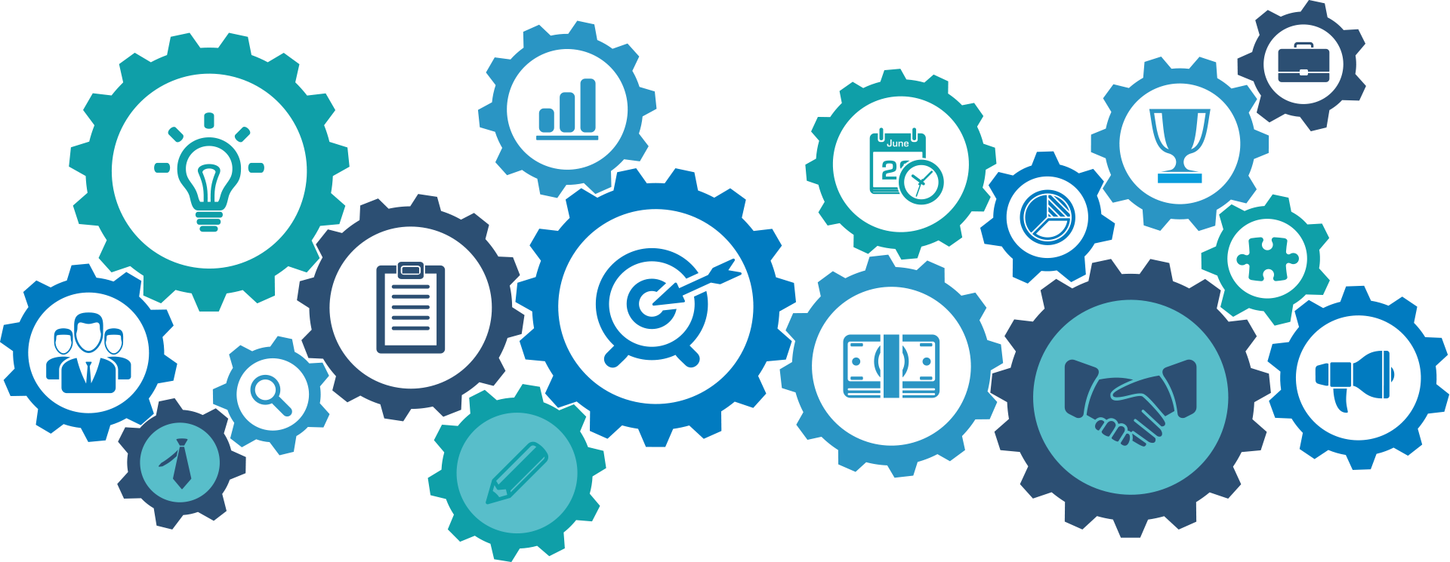
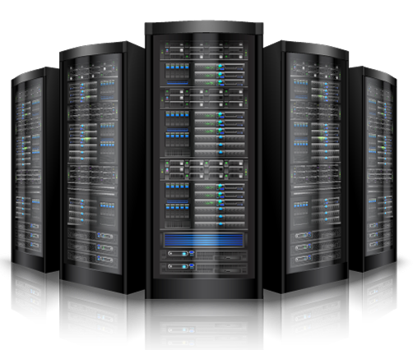
Our Delivery
Big Data Analytics
Services
Strategic asset
Operation Management
Big Data Management
operation
Business
Risk challenges
Big Data Appliance
Infrastructure
DALA Platform
Operation

Slide 26
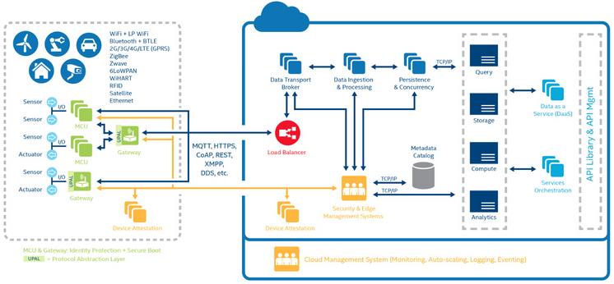

Slide 27
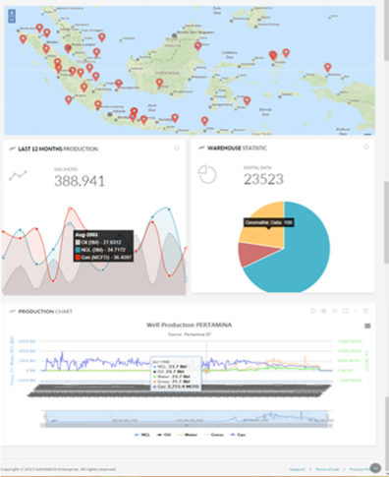
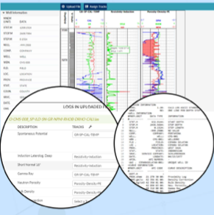
Data Analytics
Advance Visualisation
        http://makeiswork.com/2016/05/29/energy/ (pdf file) – open for video overview request

Slide 28
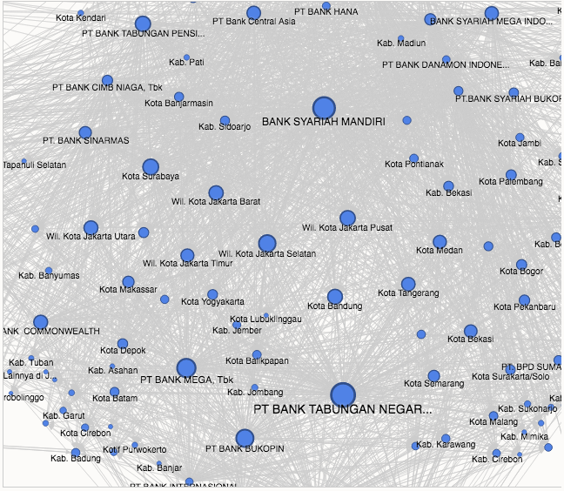
2. Fraud analysis
        Financial & Transaction
        http://makeiswork.com/2015/04/23/show-case/

Slide 29
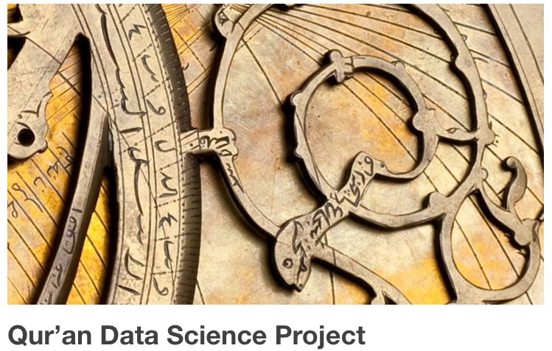
3. Qur’an Project

Slide 30
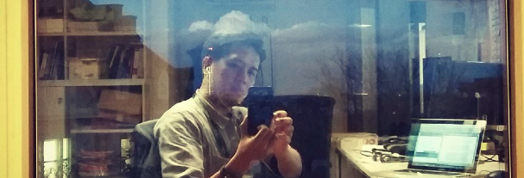
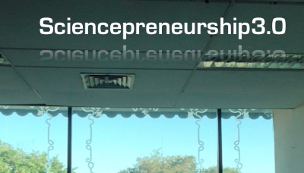
TERIMA KASIH

