Slide 1
Eco-system Startup Berbasis Science
mardhani@ugm.ac.id | mardhani.staff.ugm.ac.id

Slide 2
Poin Diskusi
StartUp dan Industri Kreatif
Problem Trivia
Ecosystem supportive
Manajemen Talenta

Slide 3
Start Up dan Industri Kreatif

Slide 4
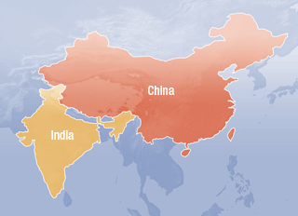

Slide 5
Lesson
Isolated Technology Nation China and India clearly are mature ecosystem by themselves, they have the technology, funding, and big market.
Advanced Technology Nation with Limited Market Japan, Korea, and Taiwan are advanced technology countries with a mature market but each has limited size.
Advanced Technology Nation with Small Market Singapore is a country with very advanced technology but no market, so they have to think globally from day one.

Slide 6
Source: https://medium.com/indonesia-internet-mobile-space/indonesia-the-emerging-startup-nation-7d83ce663204
Emerging Technology Nation with Limited Market Thailand and Philippines are quite similar to Indonesia. Vietnam is slightly behind Indonesia while Malaysia is slightly ahead of Indonesia in terms of technology and market maturity.
Indonesia is The Emerging Technology Nation with Vast Market Indonesia has a vast market, so we can sustain and scale by only targeting the Indonesian market.

Slide 7
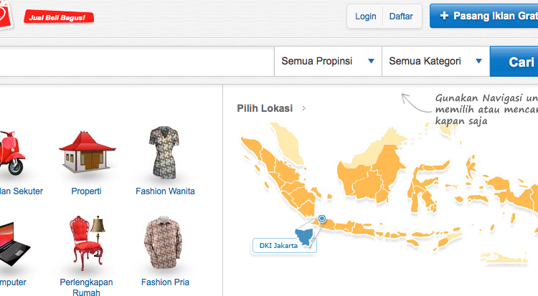
Customer Needs
Variasi channel/saluran layanan berbasis TI
Layanan berbasis personal
Munculnya “cara-cara baru” dalam bertransaksi atau berkomunikasi
Berkumpulnya orang dalam jumlah yang besar dan dalam waktu yang singkat
Potensi nilai ekonomis yang tumbuh seiring dengan tumbuhnya layanan

Slide 8
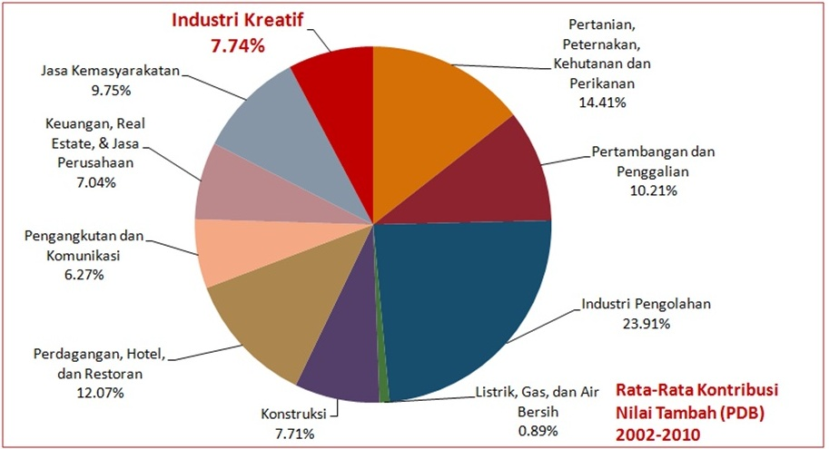
Industry landscape
Pertumbuhan sektor industri menjadi fokus pemerintah untuk menjadikannya
“engine” perekonomian sebuah negara.
http://www.indonesiakreatif.net/index.php/id/news/read/bagaimana-posisi-strategis-industri-kreatif-dalam-perekonomian-nasional

Slide 9
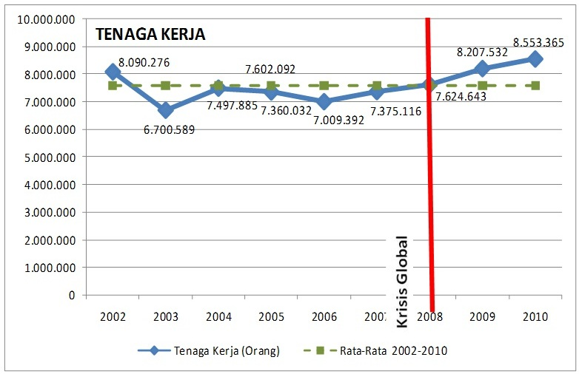
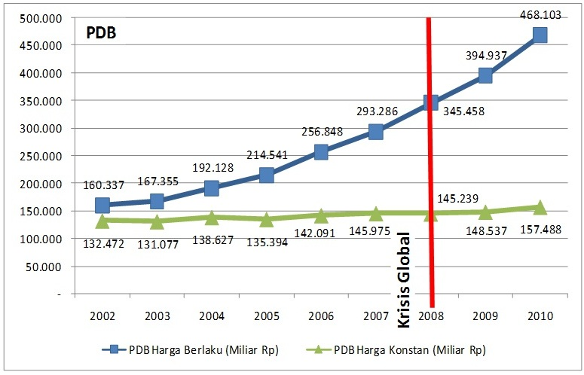
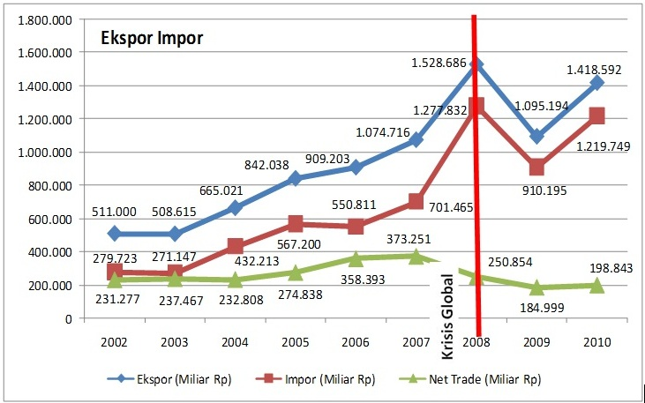
Economic outlook
Potensi tenaga kerja besar
Kinerja perdagangan prospektif
Produktifitas meningkat
http://www.indonesiakreatif.net/index.php/id/news/read/industri-kreatif-sebagai-industri-antikrisis

Slide 10
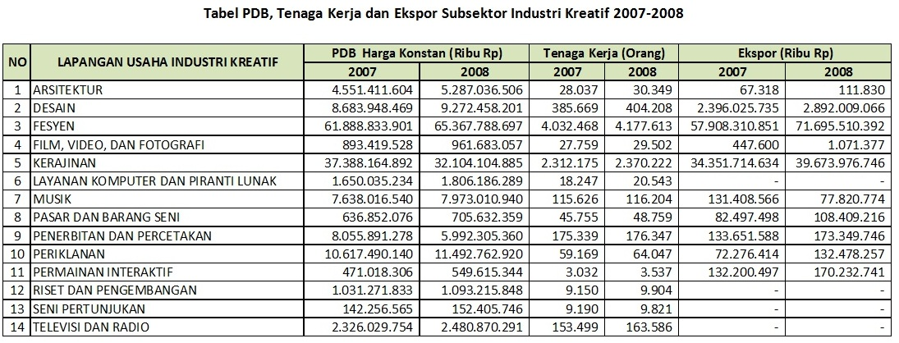
Creative industry
14 subsektor/jenis, potensi besar, dan kesempatan berkembang
http://www.indonesiakreatif.net/index.php/id/news/read/industri-kreatif-sebagai-industri-antikrisis

Slide 11
Problem Trivia dan

Slide 12
Trivia
Visualize Problems
Event, Activities, Projects
“Patern” Problems
Development & ecosystem
“Linked” Problems
Deep Problems

Slide 13
Problems
Pemerintah
Industri
Perusahaan Rintisan
Education system
Peoples

Slide 14
Manajemen Talenta

Slide 15
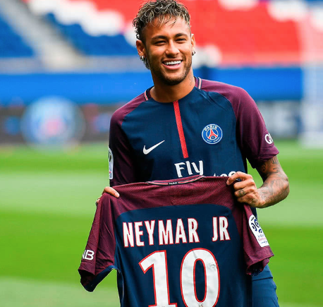
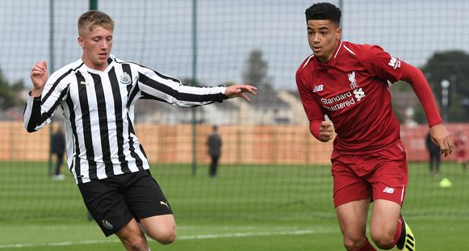
Talents
Human Resources
Human Assets
Human Capital
Shifting paradigms, talents as
Workers
Do it
Brain - idea
Collectivity
Integrity
growth
Essential component of company
Capital = assets

Slide 16
Problem landscape
Talents
Individual
Superhero thinks
Less learning paths
Instants
Applied orientation, very low in basics
Less softskill

Slide 18
Eco-system supportive

Slide 20
Techno-preneur
personal
ide
semangat
hobi
komunitas
Kepentingan
Team work
Orientasi bisnis
bisnis
Tahapan Enterpreneurships

Slide 21
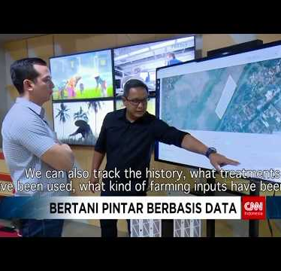
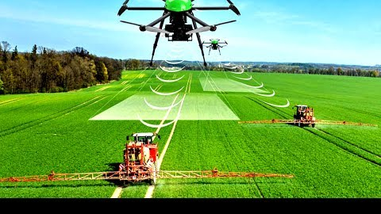

Slide 24
GamaBox.id

Slide 25
Generating “Lego” product & StartUp

Slide 26
The process
Sources
Joint & Collaboration
Idea Dev
Business Dev
Incubation
Production
scoping
scoping
Problem Discovery
Business & tech development
Industrial problem
Business case
Business & Tech development
scoping
scoping
Business case
Business & tech development
Community
Business & tech development
Product
Current Issues
Business case
scoping
scoping
Product
Business & tech development
Product
Product
FGD, Industrial MeetUp
Expo
StartUp Dive
Apprentice Program
Incubation Program
Product & startup establishment
Technology Support & Facilities
Publications
Coding & Maker School

Slide 27
Lego-ing
FGD, Industrial MeetUp
Expo
StartUp Dive
Apprentice Program
Incubation Program
Product & startup establishment
Technology Support & Facilities
Publications
Coding & Maker School
Industrial & Community Networking
Idea & Solution Gallery
StartUp and Product
Founder & Management
Talent
Product & StartUp
Lego-ing
EXIT

Slide 28
Opportunities
Internships in dalatech.id & gamabox.id
2-3 months works
Business development
Management & operation
Send your CV to mardhani@ugm.ac.id

